Slide 1
Correlation between “We The People” and Congress
Tim Blazek, Olivia Roy, Andy Shin
Social Sensing and Cyber-Physical Systems
Spring 2019

Slide 2
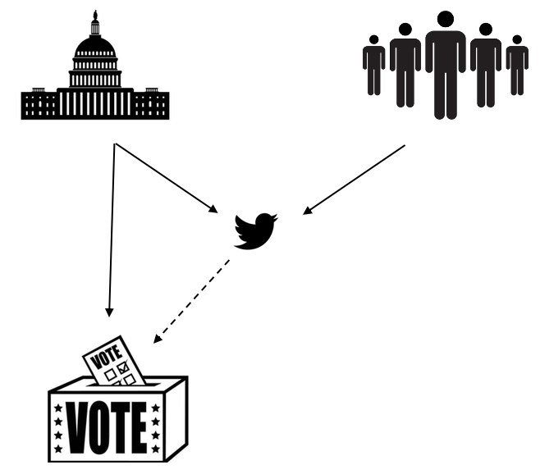
Motivation
Encourage writing and calling to Senators
Tweet political opinions and feelings
Do Senators accurately represent people?
75% of time vote with party

Slide 3
Methods
GetOldTweets library
Tweets @ Senators
How Senators voted
TextBlob for sentiment analysis

Slide 4

Methods
GetOldTweets library
Tweets @ Senators
How Senators voted
Complement Naïve Bayes Classifier

Slide 5
Progress after Midterm

Slide 6
Language Detection

Slide 7
Classifier

Slide 8
Justifying Population

Slide 9
Evaluation Results

Slide 10
Senators Results

Slide 11
Senators Results

Slide 12
Senators Results

Slide 13
Discussion

Slide 14
Limitations

Slide 15
Challenges

Slide 16
Takeaways

Slide 17
Lessons Learned
Data collection and processing
Learned how to use various classification models
Latex and creating an academic paper
Twitter is insightful, but only tells a part of the story

Slide 18
Future Work
Create a GUI that is expandable to multiple votes
Include House of Representatives
Modify and tweak classifier
Analyze links, videos, and photos in tweet

Slide 19
Questions

Slide 20
Challenges
Lack of geo-location
Voting on party lines
Amdt. 270 – Vote to repeal Obamacare
July 25, 2017
Sentiment analysis
“Obamacare is death”
"We can do better than Obamacare”
Mapping Twitter user to corresponding Senator

